Slide 1
Welcome!
Welcome to the course!
What is Splunk?
How to be successful
Where to get help
Notes:
Hey everyone and welcome to this course! I am excited to be working with you in this course.
Before we begin, let’s talk about who should take this course. This course is for you if:
You have inherited a Splunk environment and aren’t sure where to start
You’ve been tasked with building and “owning” Splunk in your organization
You want to gain Splunk skills to boost your resume
You are interested in getting started with Splunk
This course is probably not for you if
You have been working in Splunk for more than two years
You already hold Splunk certifications
You are looking to get the Splunk Certified Administrator credential—I have another course for that here on Udemy

Slide 2

Obligatory Slide
MS, Information Systems
Splunk Certified Administrator
University lecturer
Online course author
Industry practitioner
Shawna JC Tenney Illustration
shawnajctenney.com
© Adam Frisbee, adamfrisbee.com

Slide 3
Welcome to the Course!
Notes:
Welcome! I am so glad you’re here. Splunk is the most important enterprise software suite for data-geeks everywhere: from data engineers, data scientists, security professionals, to business intelligence professionals. Splunk is a BI tool and a SIEM (security information and event management) platform.

Slide 4
Splunk Every Day
5 Minutes
Success!
Follow along
Quizzes: 100%
© Adam Frisbee, adamfrisbee.com
Notes:
There are four parts to being successful in this course
Splunk every day
Commit to five minutes of this class every day
Don’t move on to the next section until you pass the current sections quiz with 100%
Follow along with the demos

Slide 5



Downloadable slides
Homework
Official Splunk documentation
© Adam Frisbee, adamfrisbee.com
Notes:
Resources:
All slides are downloadable. You should download them and follow along with the lectures.
Homework and quizzes are made available for checks on your learning. Complete them.
Refer to the official Splunk documentation for anything and everything related to Splunk.

Slide 6

Getting Help
Splunk Community
Community.splunk.com
Splunk documentation
docs.splunk.com
Course Q&A
Notes:
You will get stuck from time to time. Luckily, there are places to get help.
The Splunk community will never let you down. Especially the Splunk Answers section. This is a Stack Overflow format question and answer community, except no one is rude. You can ask any Splunk question from absolute beginner questions to the most advanced questions. I’ve never had any of my questions go unanswered for longer than a few hours. Splunk pros hang out there.
We have a vibrant community here on Udemy where you can post questions and answer others’ questions. I’ll pop in there from time to time, but in a community with ten—of-thousands of students, I obviously can’t answer every question.

Slide 7
Legal
Disclaimer
This course is not affiliated with or endorsed by Splunk Inc.
I do not work for Splunk, Inc. and I am not in any way affiliated with Splunk Inc.
The information presented here is from my own experience, and from the publicly available documentation found at docs.splunk.com
The fonts used are open source, including the > which resembles the Splunk logo, but is just a >
© Adam Frisbee, adamfrisbee.com

Slide 8

Course Rating
Rating courses is very helpful to instructors. Please take a minute to rate this course.
© Adam Frisbee, adamfrisbee.com

Slide 9

Let’s Get Started!

Slide 10
What is Splunk?

Slide 11
What is Splunk? >
Machine data
Structured data
Unstructured data
Reports, alerts, dashboards
© Adam Frisbee, adamfrisbee.com
Notes:
What is Splunk?
Hidden in your organization’s data is a gold mine of useful, actionable knowledge. Data is generated by everything in the modern world—humans generate data by their actions (web clicks, purchases, logins, everything they do). Machines generate data because they record literally everything they do and everything that happens to them. Things like syslogs, application logs, and other metrics.
Splunk takes this data--any type of data: unstructured, structured, machine generated, human generated--and allows you to create real value from that data in the form of rich reports, live dashboards, and triggered alerts

Slide 12
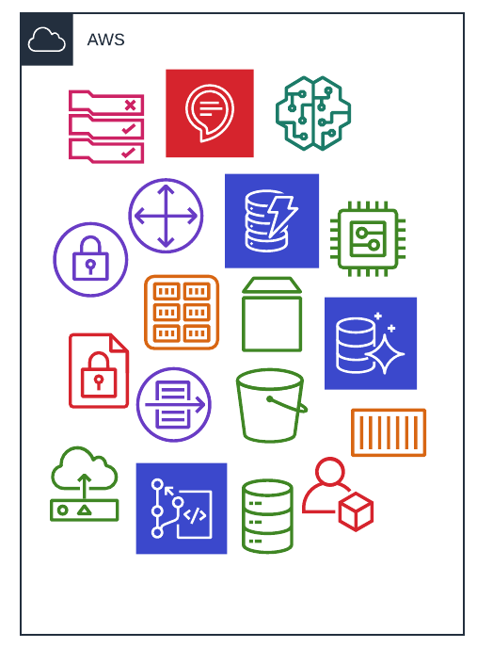
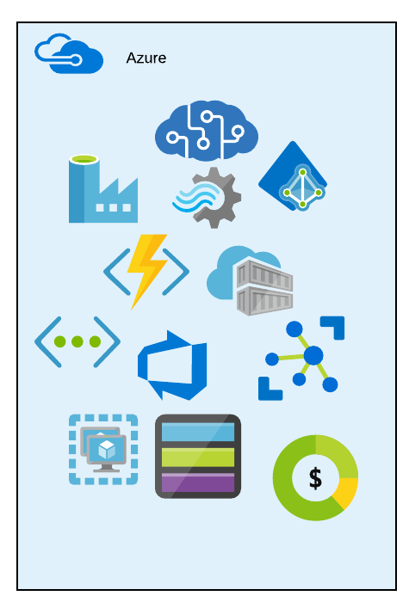
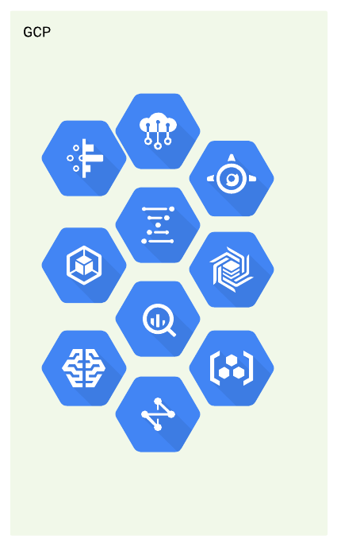
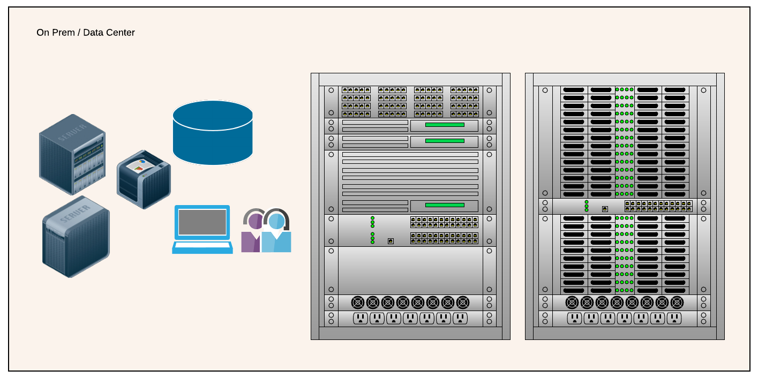
What is Splunk? >
© Adam Frisbee, adamfrisbee.com
Notes:
Consider a typical, modern organization. It might have some assets in various cloud providers: perhaps Office 365 with Azure AD, and maybe a few other Azure services. It might have some big data solutions built out in GCP, and some infrastructure in AWS. It likely also has on premises assets like laptops, desktops, physical servers, physical storage, networking gear, and so on.
Each and every one of these items—indeed, every single machine—knows and can log exactly what happens to it at any given moment. It logs incoming requests, outgoing messages, users and other systems with which it interacts, actions it takes and much, much more. Anyone who has sifted through a log file export knows what I am talking about.
But what generally happens to all of this data? It gets dumped into a veritable black hole. Nobody looks at it or cares about it until there is a problem. Then, IT pros are left with manually searching through tens-of-thousands, hundreds-of-thousands, and sometimes millions of log entries trying to investigate the situation.

Slide 13

What is Splunk? >
>
© Adam Frisbee, adamfrisbee.com
© Adam Frisbee, adamfrisbee.com
Notes:
Friends, there’s a better way.
With Splunk, we can set up a system to capture this data, clean it, format it, transform it, and make it sing!

Slide 14
What is Splunk? >
PChUkRtaKKnCoRCZ7ryyUbUJ0E4koARasE9RATt9j7a
G0usmzJ7BPKuaEcpy puP1U9q8PHMmeu9VLd3CNE
Qu5XFinVEDRhbASc17BwvKTnkbqkzFSWudhR7W
np4NR13iy6XPuhOjiiIX8SZXlx60l7323twWecHm
uxtgbyxKaLXB3FMfp3pGADdt3mWQ24LMF7g1gW5L
system_name
system_state
system_geo
© Adam Frisbee, adamfrisbee.com
Notes:
Splunk is great at reading and parsing machine data, but it’s much more than that. It’s a fully fledged BI tool, data analytics tool, SIEM tool, data science tool, and more!
For just one of it’s super powers, consider machine data:
Typical data generated by machines (and by machines I mean systems of any kind: cloud or on prem, containers or virtual or physical systems, vehicles and IoT devices, etc.) generate data that is cryptic. That is to say that it is not human friendly. It looks similar to this. An unreadable mess—unreadable by humans, that is.
With Splunk, we can train it to look for certain patterns called “regular expressions” and then label those patterns as fields. We can then take those fields and build intelligence systems that show us the data in an understandable way.
That’s what this class is all about. Can you imagine how valuable someone with this skillset is in the workforce? That’s why you enrolled in this class, and together, we are going to boost your resume!

Slide 15
What is Splunk? >
PChUkRtaKKnCoRCZ7ryyUbUJ0E4koARasE9RATt9j7a
G0usmzJ7BPKuaEcpy puP1U9q8PHMmeu9VLd3CNE
Qu5XFinVEDRhbASc17BwvKTnkbqkzFSWudhR7W
np4NR13iy6XPuhOjiiIX8SZXlx60l7323twWecHm
uxtgbyxKaLXB3FMfp3pGADdt3mWQ24LMF7g1gW5L
system_name
system_state
system_geo
PChUkRtaKKnCo | P1U9q8PHMmeu9 | uxtgbyxKaLXB3
© Adam Frisbee, adamfrisbee.com
Notes:
Splunk is great at reading and parsing machine data, but it’s much more than that. It’s a fully fledged BI tool, data analytics tool, SIEM tool, data science tool, and more!
For just one of it’s super powers, consider machine data:
Typical data generated by machines (and by machines I mean systems of any kind: cloud or on prem, containers or virtual or physical systems, vehicles and IoT devices, etc.) generate data that is cryptic. That is to say that it is not human friendly. It looks similar to this. An unreadable mess—unreadable by humans, that is.
With Splunk, we can train it to look for certain patterns called “regular expressions” and then label those patterns as fields. We can then take those fields and build intelligence systems that show us the data in an understandable way.
That’s what this class is all about. Can you imagine how valuable someone with this skillset is in the workforce? That’s why you enrolled in this class, and together, we are going to boost your resume!

Slide 16
Introduction to the course
Who this course is for
How to be successful
Where to get help
Brief introduction to Splunk and what it can do
BI, SIEM
Unstructured data into insights

